Slide 1

DFN40323 Programming Essentials in Python
Lecturer Name
Sharizan Binti Abdul Jamil

Slide 2

Presenter
Muhammad Afiq Muhaimin Bin Mohd Zaini
32DDT20F2029

Slide 3
Differences between List, Tuple and Dictionary

Slide 4
01
List

Slide 5


What is A list
List are used to store multiple items in a single variable
It is one of 4 built in data types in Python which is used to store collections of data
How to create a list?

Slide 6

Characteristics of a list
Ordered
The items inside of the list are ordered which means they have a defined order and will not change
If a new item is added, the new item will be placed at the end of the list
Changeable
The list is changeable, meaning that we can change, add, and remove items in a list after it has been created.
Allow Duplicates
Since lists are indexed, lists can have items with the same value

Slide 7




Data types of list
String
Int
Boolean

Slide 8
02
Tuple

Slide 9


What is A tuple
List are used to store multiple items in a single variable
It is one of 4 built in data types in Python which is used to store collections of data
How to create a tuple?

Slide 10

Characteristics of a tuple
Ordered
The items inside of the tuple are ordered which means they have a defined order and will not change
If a new item is added, the new item will be placed at the end of the tuple
Unchangeable
Tuples are unchangeable, meaning that we cannot change, add or remove items after the tuple has been created.
Allow Duplicates
Since tuple are indexed, lists can have items with the same value

Slide 11



Data types of list
String
Int
Boolean

Slide 12
03
Dictionary

Slide 13
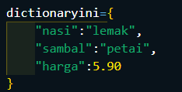
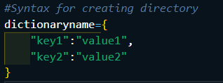
What is A dictionary
Dictionaries are used to store data values in key:value pairs.
A dictionary is a collection which is ordered, changeable and do not allow duplicates.
How to create a dictionary?

Slide 14
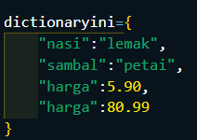
Characteristics of a dictionary
Ordered
The items inside of the dict are ordered which means they have a defined order and will not change
If a new item is added, the new item will be placed at the end of the dict
Changeable
The dict is changeable, meaning that we can change, add, and remove items in a dictionary after it has been created.
Does not Allow Duplicates
Dict cannot have two items with the same key
If there’s duplicate value, it will overwrite existing values

Slide 15
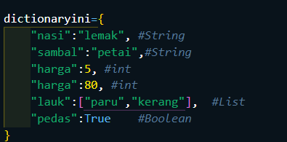
Data types of dictionary

Slide 16
Differences between list, tuple and dictionary
Category | List | Tuple | Dictionary
Meaning | Non-Homogeneous Data structure | Non-Homogeneous Data structure | Non-Homogeneous Data structure which stores data in key:value pairs
Symbol | [ ] | ( ) | { }
Example | [1, 2, 3, 4, 5] | (1, 2, 3, 4, 5) | Nombor={ “one”:1 }
Usage | Array Databases | SQL Query Parentheses checker | Used to create a data frame with lists Used in JSON

Slide 17
References
Python Dictionaries. (n.d.). Retrieved October 3, 2022, from https://www.w3schools.com/python/python_dictionaries.asp
Python Lists. (n.d.-b). Retrieved October 3, 2022, from https://www.w3schools.com/python/python_lists.asp
Python Tuples. (n.d.). Retrieved October 3, 2022, from https://www.w3schools.com/python/python_tuples.asp

Slide 18
Thank You ☺

